Slide 1
Plastic Machine by Peo
Kit Installation Guide
This Machine is designed to work plastic into shapes. Good for Makers and Crafters

Slide 2
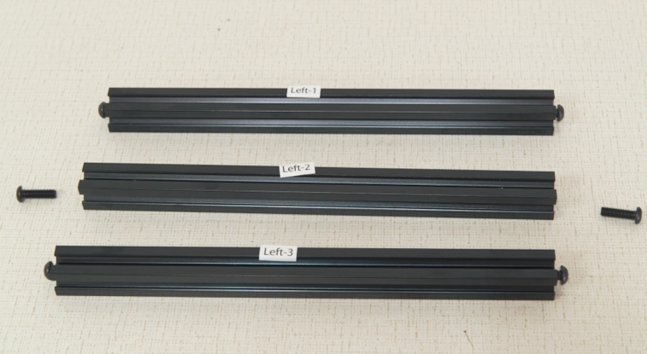
Please find these 3 bars
They are labeled:
“Left1”
“Left2”
“Left3”

Slide 3
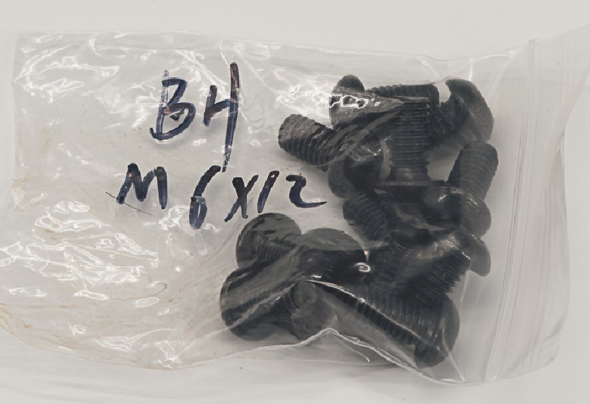
Please get 4 screws from the bag labeled “BH M6x12”
And screw two per bar half way on “Left1” and “Left3”
Screw them in until there is 3 to 5mm remaining out
This will make it easier to align with the slots in the frame in later steps.

Slide 4
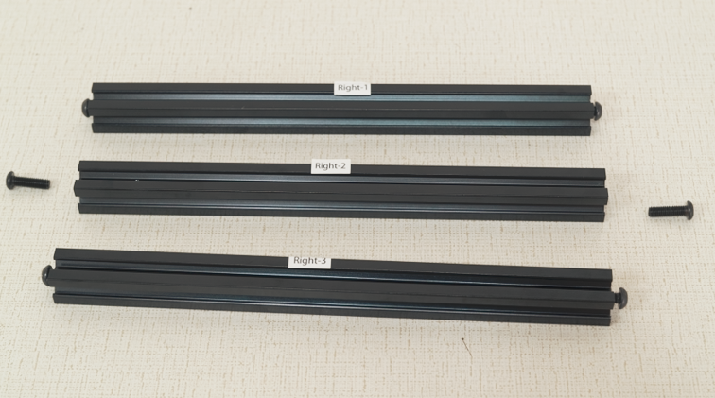
Please find these 3 bars
They are labeled:
“Right1”
“Right2”
“Right3”

Slide 5
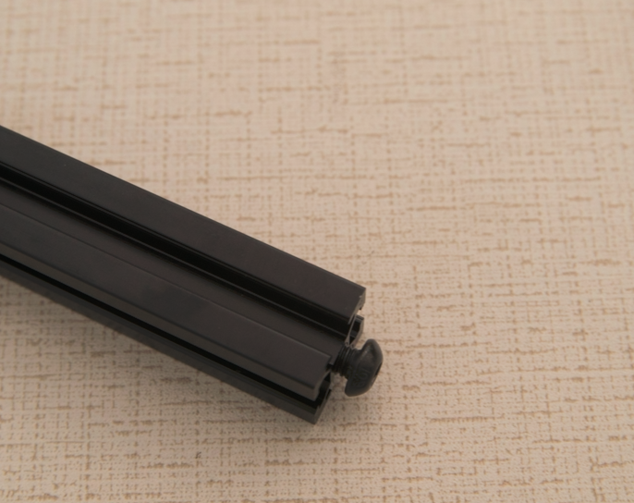
Please get 4 screws from the bag labeled “BH M6x12”
And screw two per bar half way on “Right1” and “Right3”
Screw them in until there is 3 to 5mm remaining out
This will make it easier to align with the slots in the frame in later steps.

Slide 6
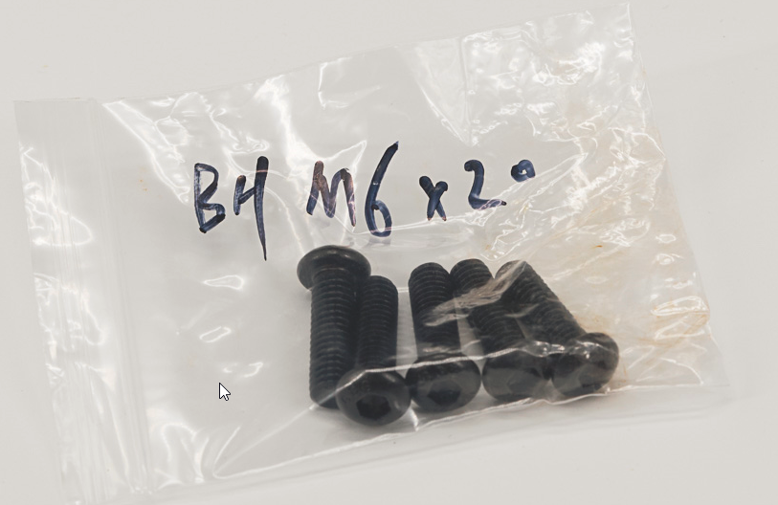
Please get 4 screws from the bag labeled “BH M6x20 “
These are for Left2 and Right2 bars. 2 Each bar. Use it later
Screw them in until there is 3 to 5mm remaining out
This will make it easier to align with the slots in the frame in later steps.

Slide 7
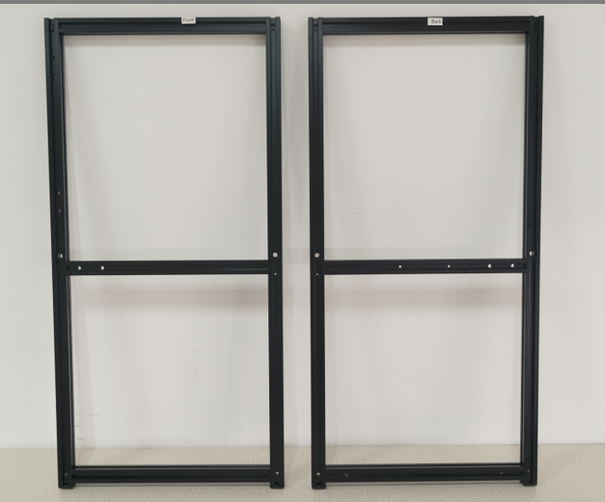
Please find assembled front and back frame labled Front and Back
The front frame has labels start with Front
The back frame has labels start with Back
The side of each frame that is facing outward is where the sticker is located

Slide 8
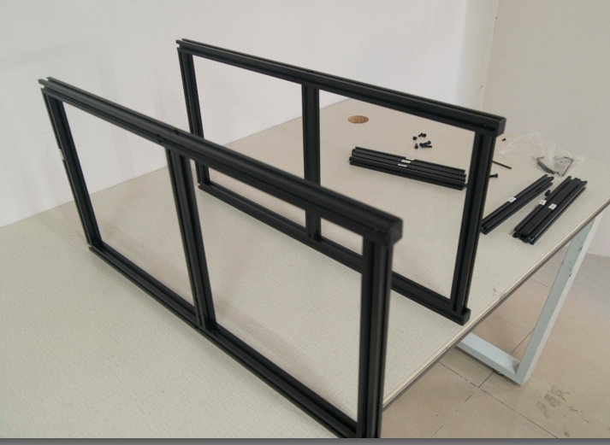
Put Front and Back Frame in parallel on the table
Put Front on the left hand side, sticker facing left. Rubber feet facing you
Put Back Frame on the right. Sticker facing right. Rubber feet Facing you.
Where Sticker is facing is important. The stickers for the front and the back should be facing away from each other

Slide 9
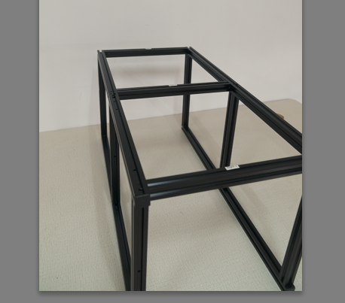
Install Right1, Right2, Right3 bar between Front and Back frame
First Install Right3, put the screw between extrusion and slide all the way down toward to rubber feet.
Then Install Right2, Use the previous found BH M6-20 to secure it in the middle by locking from outside (ADD MORE)
Finally Install Right1
Sticker side of bar should face outward
Do not overtighten - you may need to adjust things slightly in later steps.

Slide 10
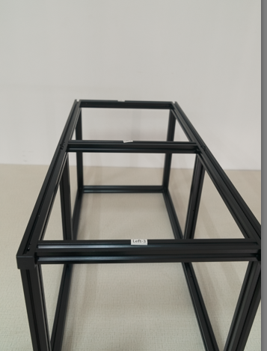
Install Left1, Left2, Left3 bar between Front and Back frame
Flip the frames over
First Install Left3, put the screw between extrusion and slide all the way down toward to rubber feet.
Then Install Left2, Use the previous found BH M6-20 to secure it in the middle
Finally Install Left1
Sticker side of bar should face outward
Do not overtighten - you may need to adjust things slightly in later steps.

Slide 11
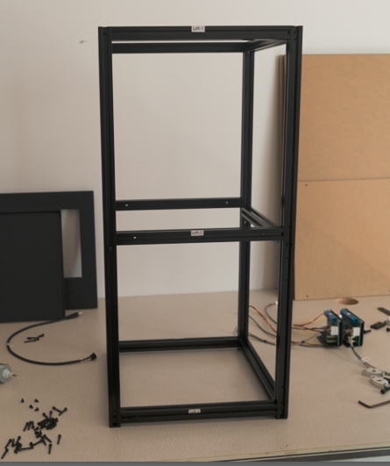
The frame should look like this when it is done correctly
Stickers from all 4 sides should facing outward, like the picture shown

Slide 12
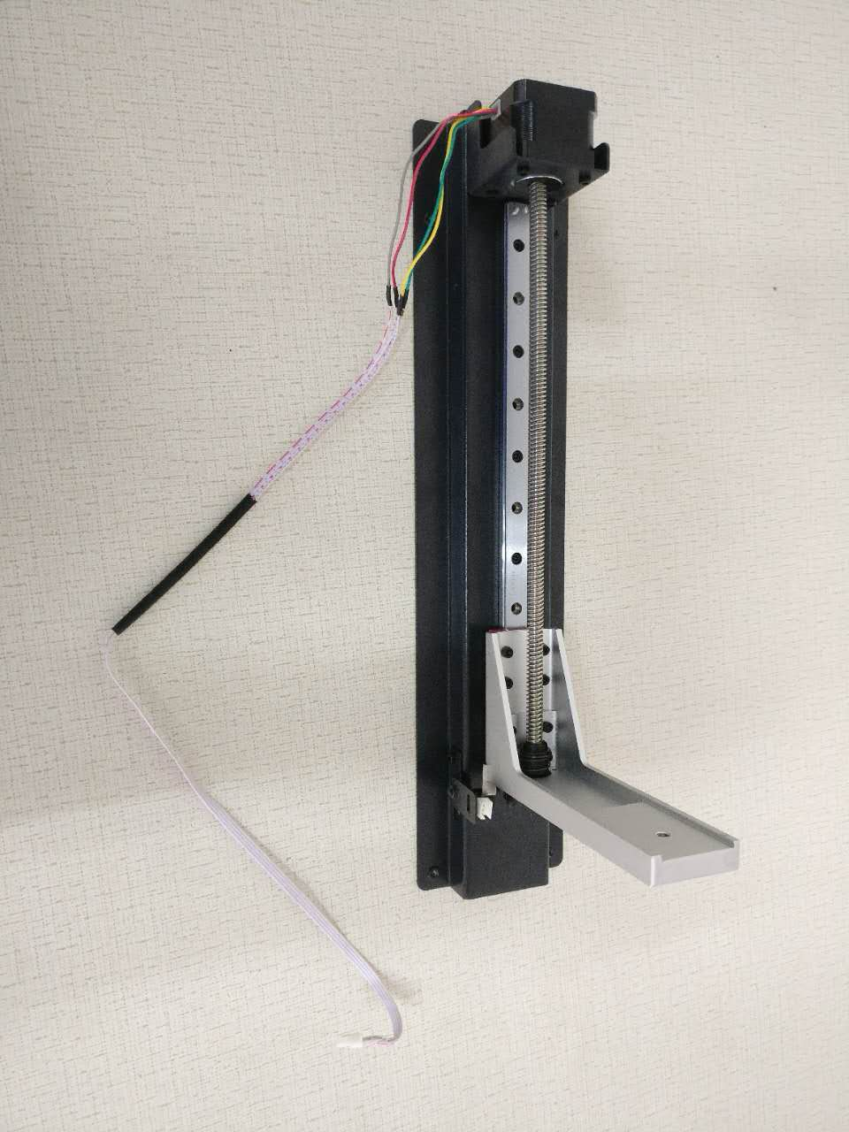
Find the assembled Z-Axis in the box that looks like this
video tutorial part 4

Slide 13
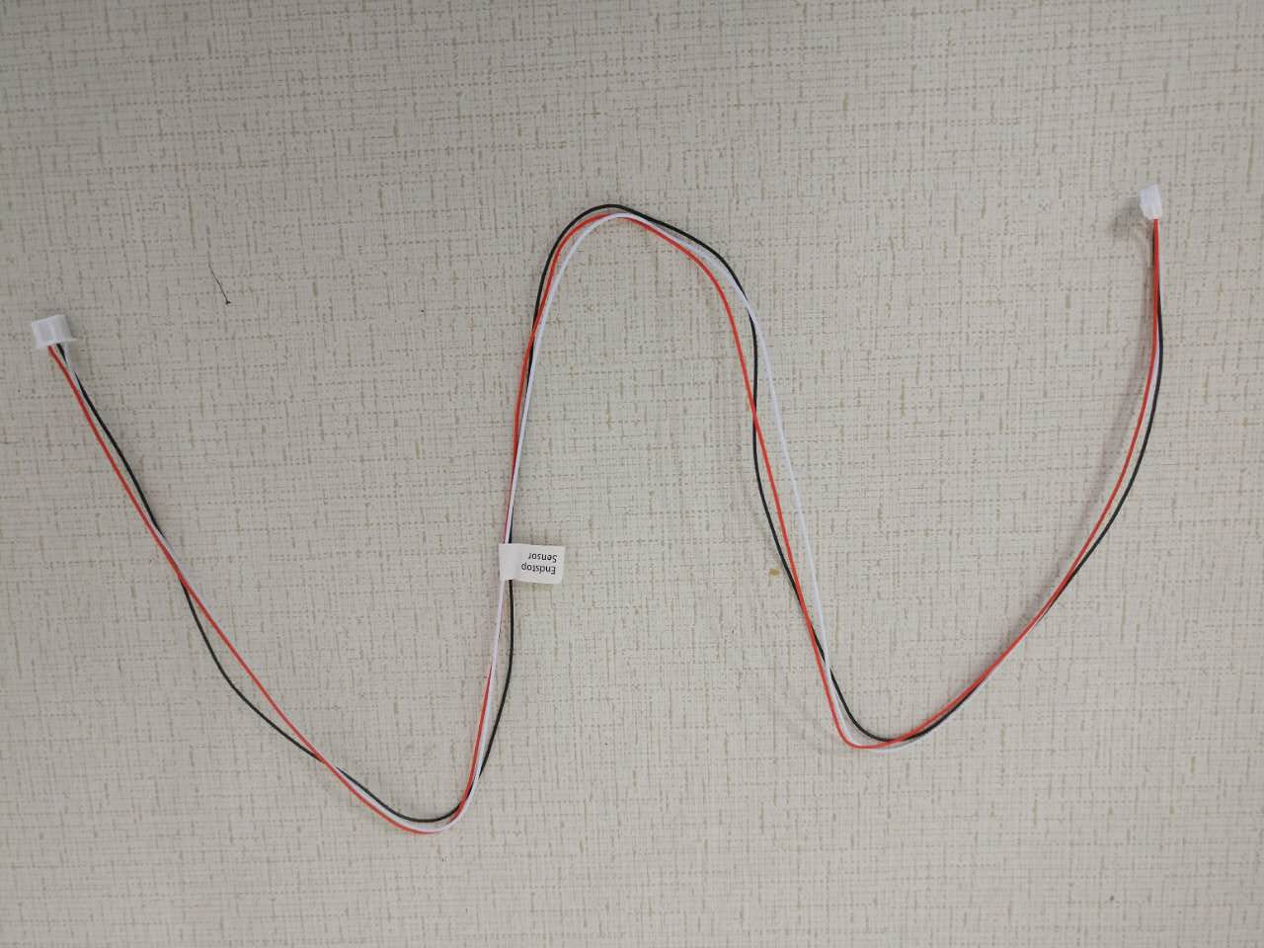
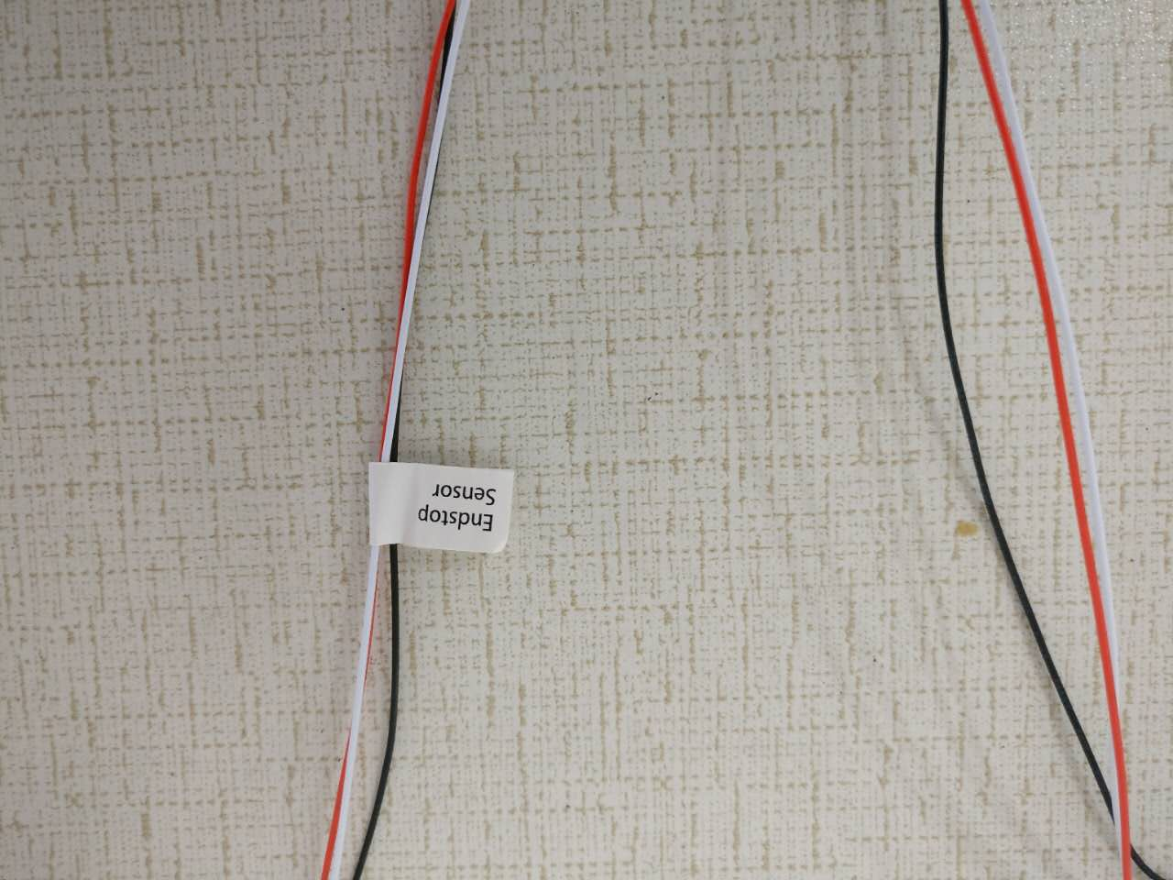
Find the Endstop Sensor cable that looks like this
video tutorial part 4

Slide 14
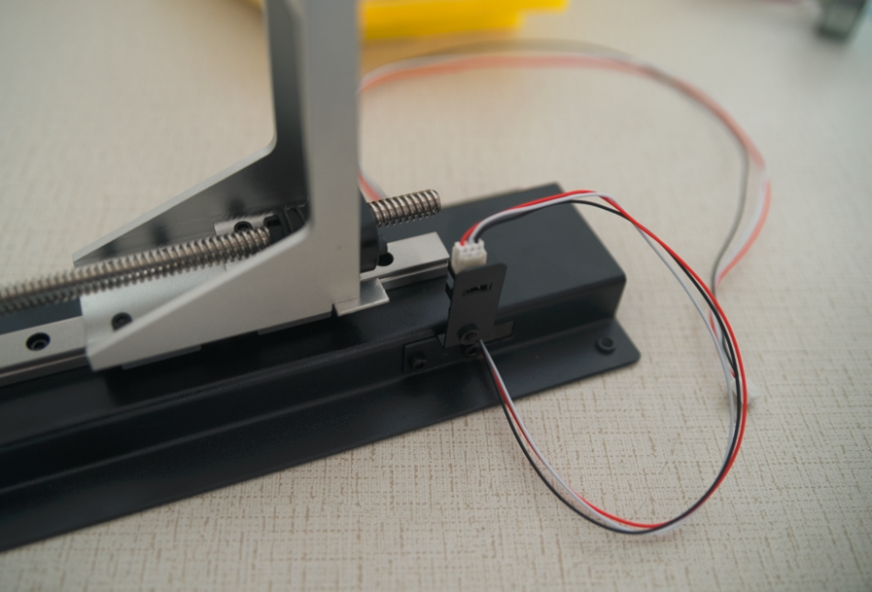
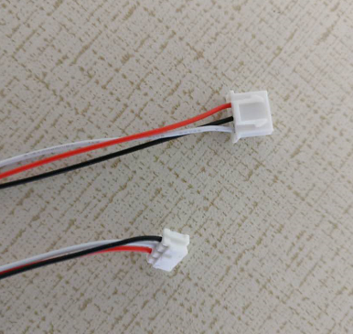
Connect Endstop Sensor cable to Z-axis as following
video tutorial part 4
The smaller connector on the endstop sensor cable goes into the socket on the Z-axis.
Ensure connection is secure as this is needed to stop Z-axis motor from over extending the build plate arm

Slide 15
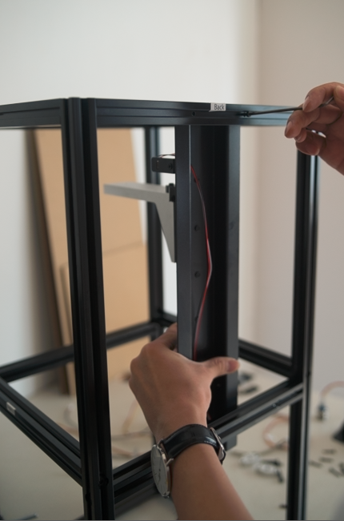
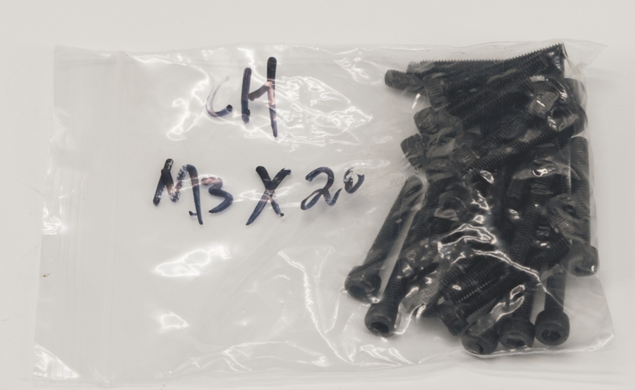
Find 4 CH M3-20 screws and use it to Mount Z-Axis to Back frame
video tutorial part 4
The bolt head goes on the outside of the frame and screws into the built-in threads
on the Z-axis.

Slide 16
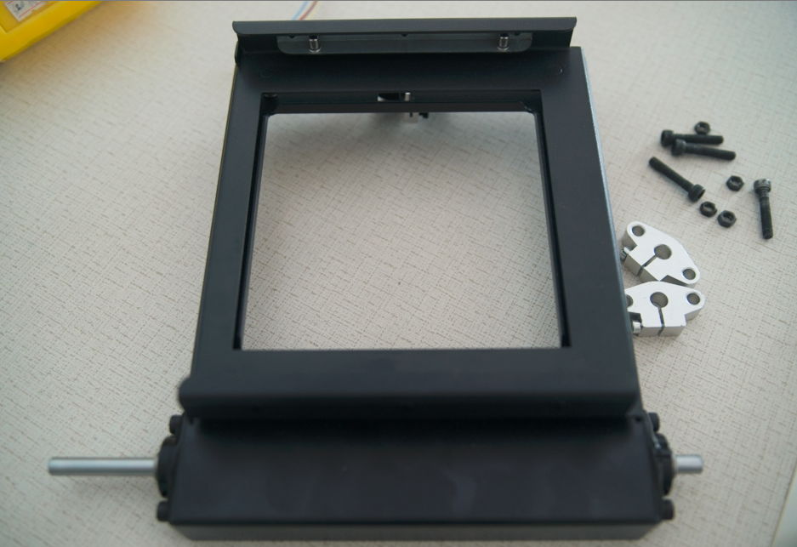
Once the Z-Axis is secured, find the Platform, it comes assembled
video tutorial part 4

Slide 17
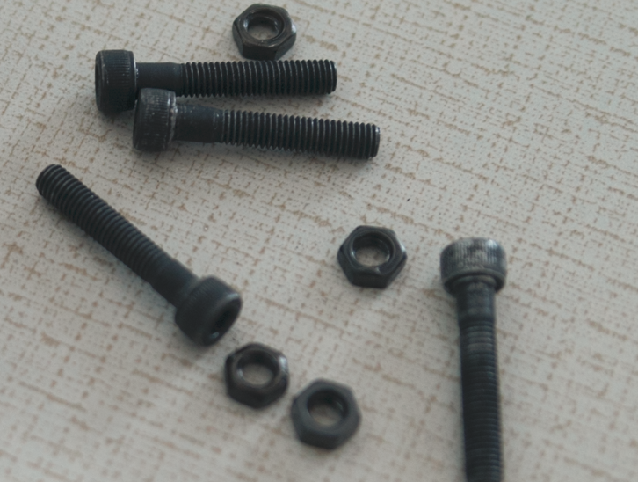
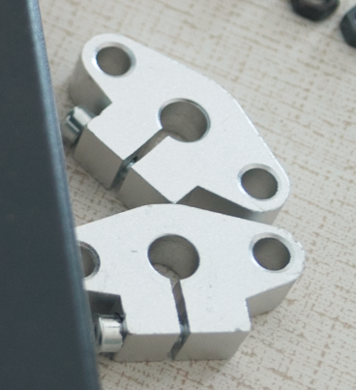
Find 4 CH M5-27 screws and nut. two silver looking bracket
video tutorial part 4

Slide 18
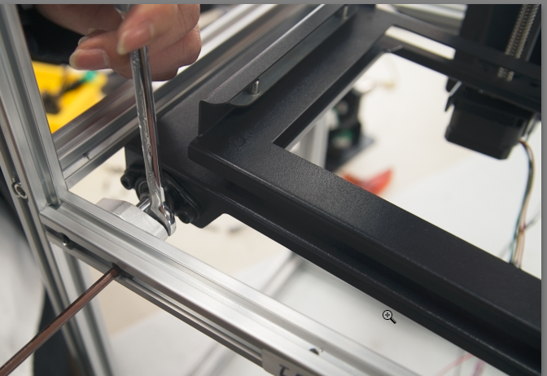
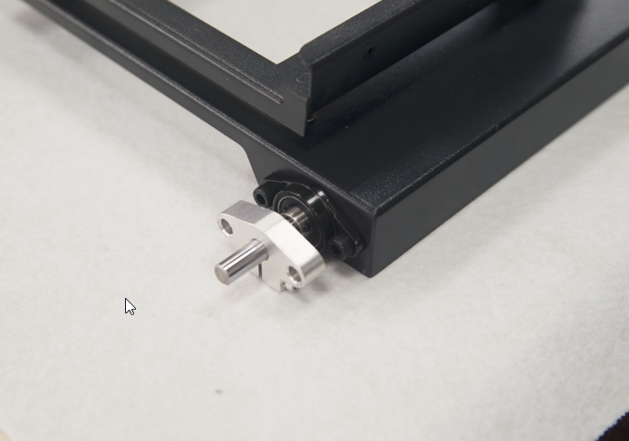
Put the Silver Bracket on the Platform’s metal rod.
Install the Platform cross from Front and Back frame with the beam is close to the Left Frame Use CH M5-27 screws to secure. Should install both Silver Brackets first before tightening. Silver Brackets as it touch both Front and Back frame. You don’t want this to wiggle too much
video tutorial part 4

Slide 19
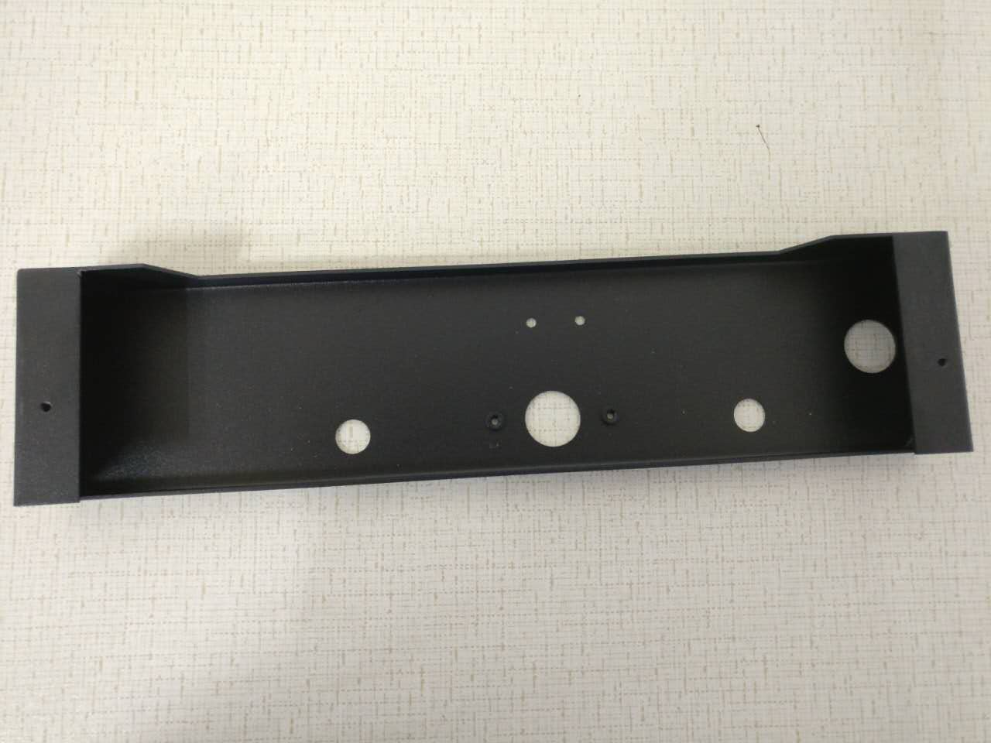
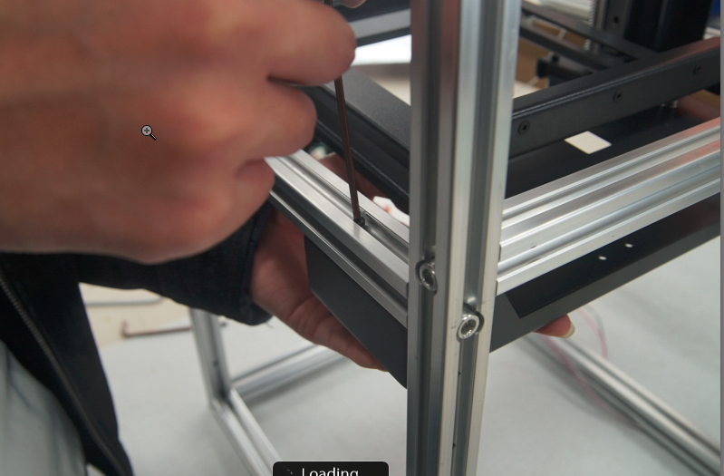
Find the below metal piece in the lower right piece secure it with between Front and Back frame near Right side. 4 CH M3-20 screws
This is easiest if you insert the top 2 screws first, then the back 2 should go in easily.
video tutorial part 4
Right Frame
Front Frame
Right Frame

Slide 20
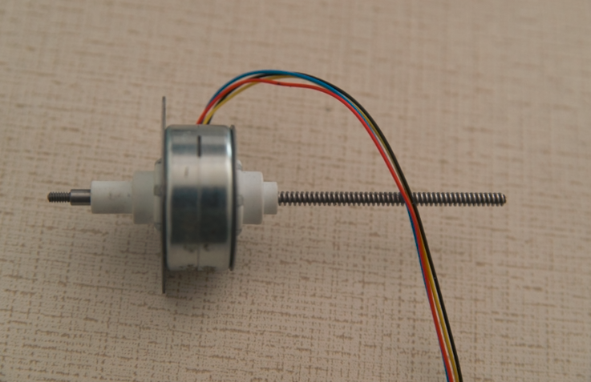
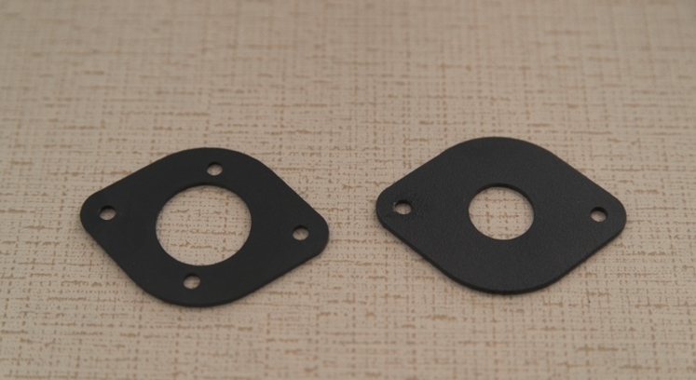
Find the Rise Motor and the two Brackets
Video Tutorial part 5

Slide 21
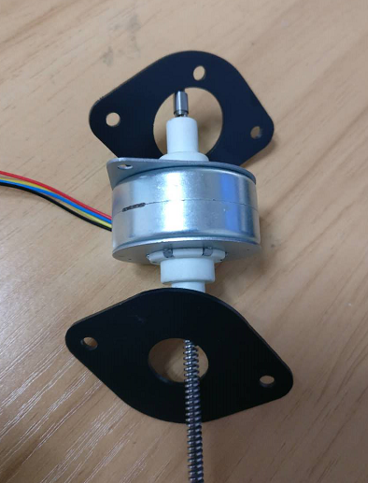
Install Brackets on Rise Motor like this
The bracket with larger center hole goes in first
Video Tutorial part 5.

Slide 22
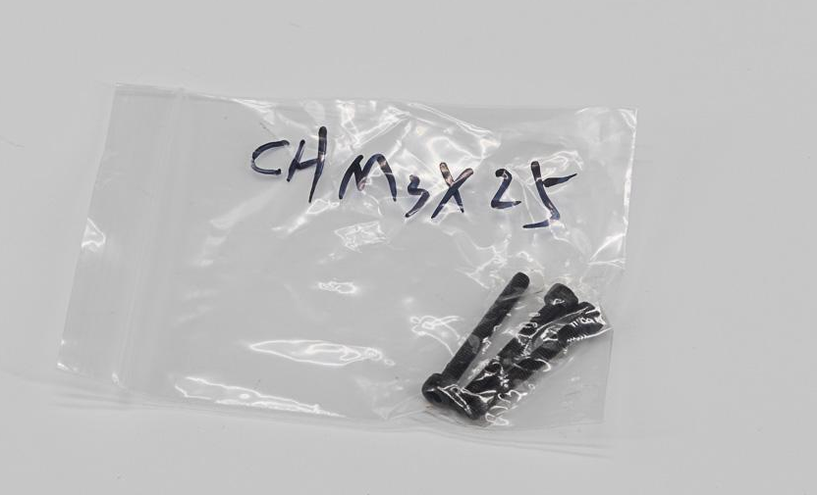
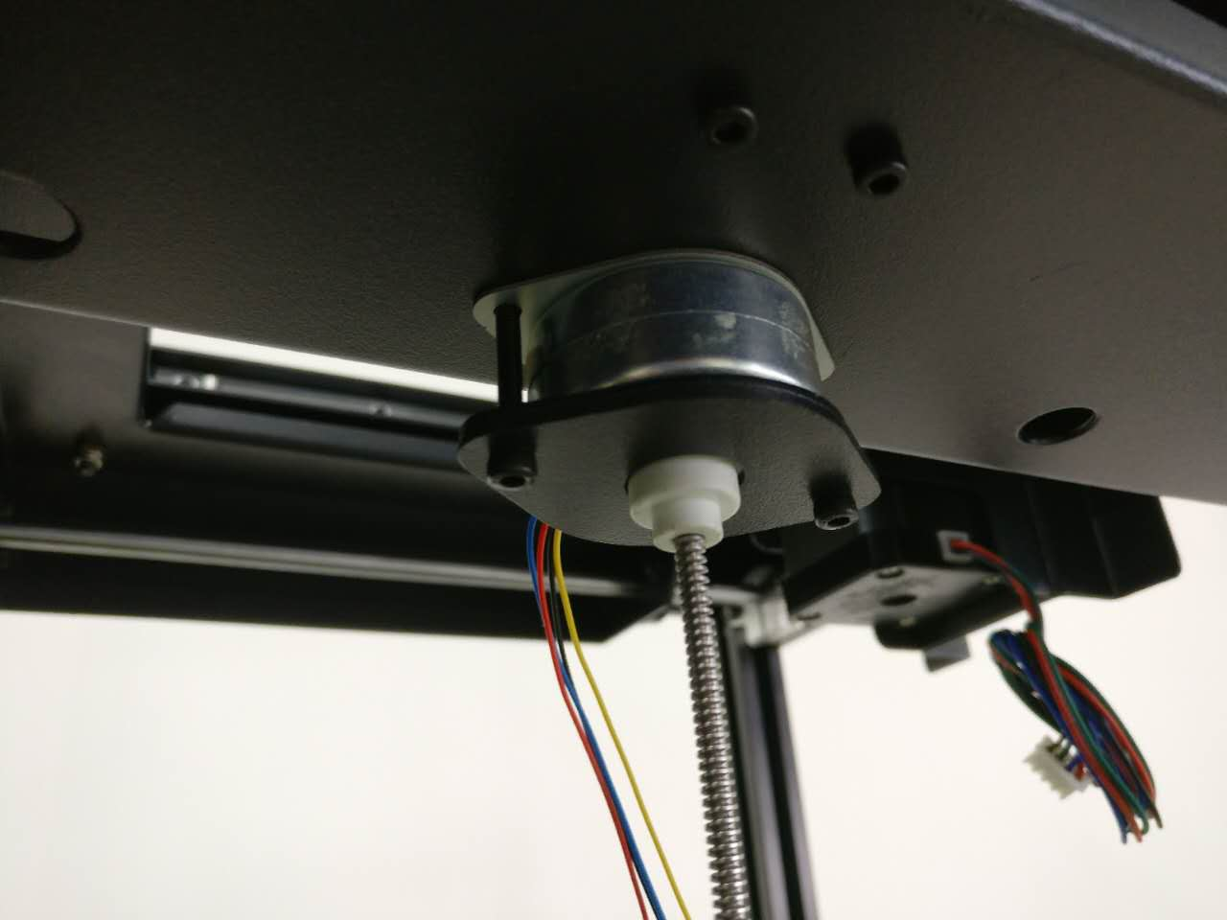
Secure Rise Motor with CH M3-25 from the bottom near Right frame Video Tutorial part 5

Slide 23
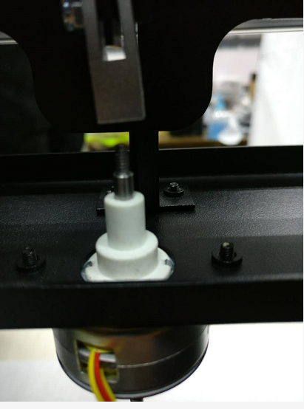
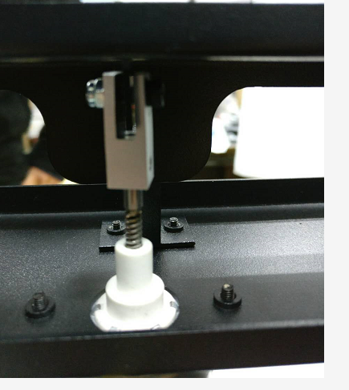
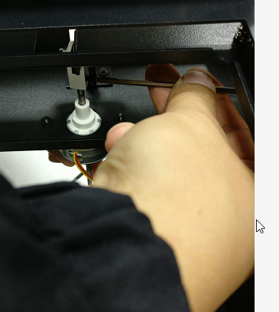
Use hand to turn the long threaded beam on Riser Motor upward, such that it screws into the tiny Silver Metal Part. Move the beam up to a point where the unthreaded metal cylinder touches Silver Metal Part. The use the CH M3-4 to tighten it. No need to over secure it. Make sure the Silver Metal Part is straight with the Riser Motor’s beam Video Tutorial part 5

Slide 24
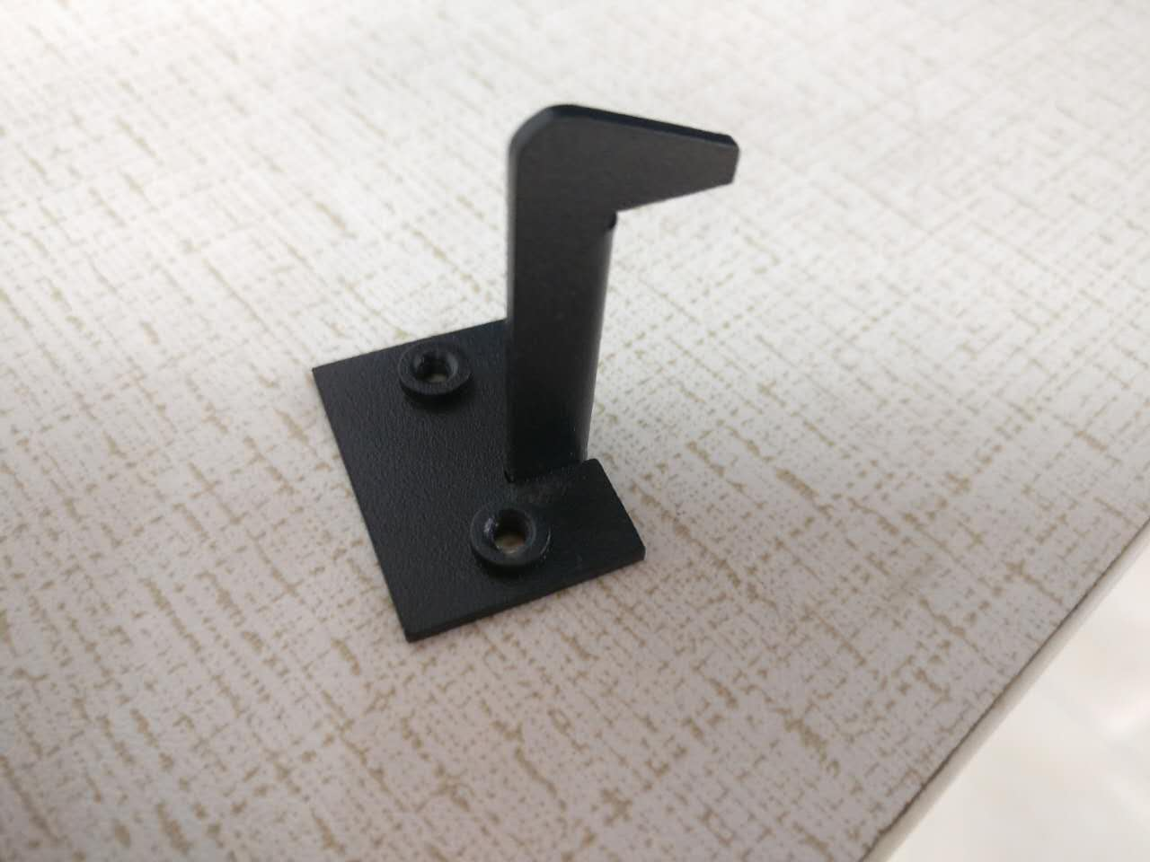
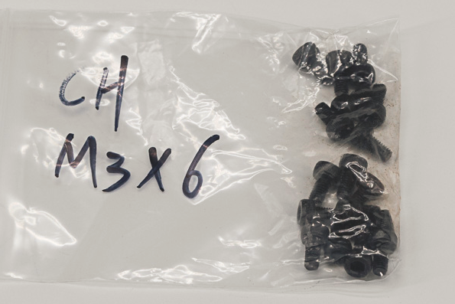
Find this Metal Piece with Hook. And 2 CH M3-6 screws
Video Tutorial part 5

Slide 25
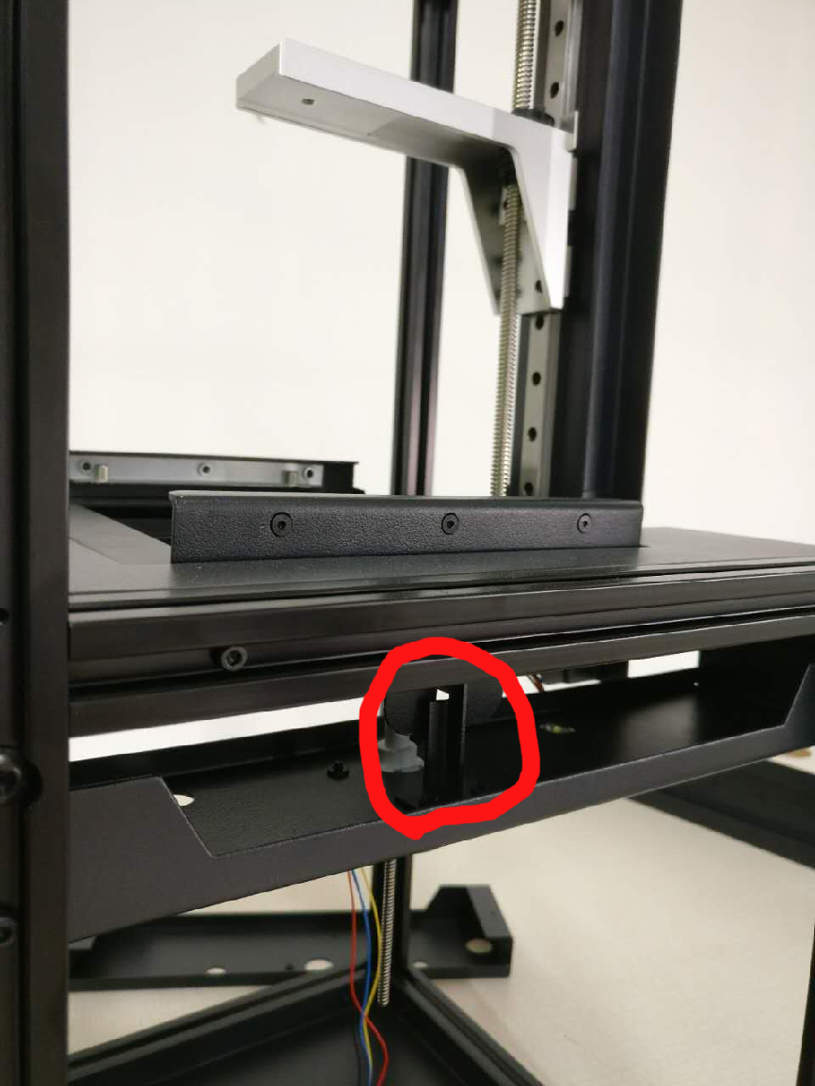
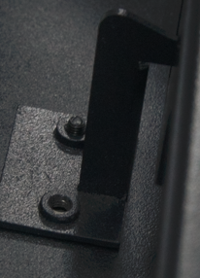
Secure Metal Piece with Hook. At the circle spot with CH M3-6 screws
Video Tutorial part 5

Slide 26
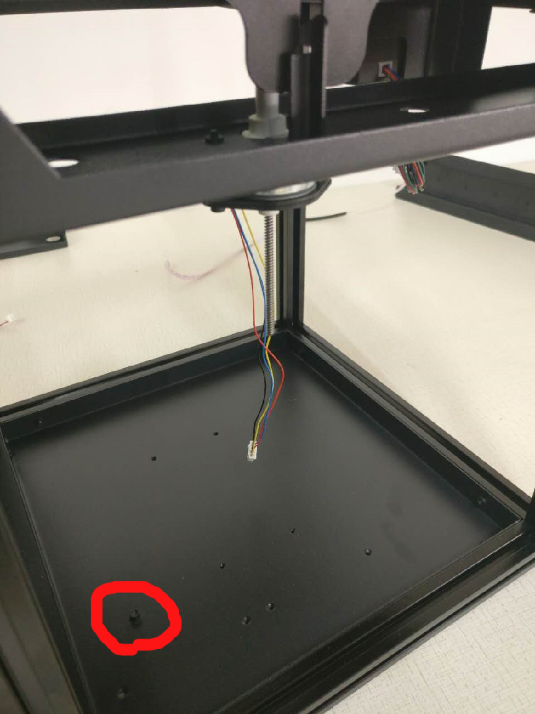
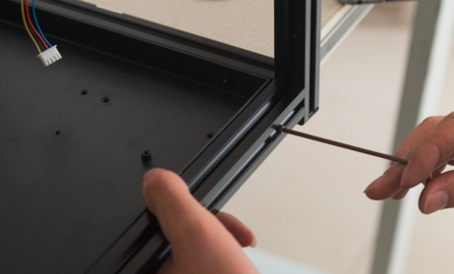
Find the Bottom piece, it has several screw holes on it and one very pronounced screw hole that rise up. The pronounced screw hole should be closest to the Front Frame. Ues 8 CH M3-20 screws 2 on each side to secure on 4 sides
Video Tutorial part 5
Installer note:
put the screws for front and back in first. If left and right 3 bars were not perfectly aligned, you may need to loosen their screws and align them to the bottom plate (by inserting the screws for the plate), then tighten the bar bolts down. None of the screws should require much force to start - if they do, it means something isn't aligned.

Slide 27
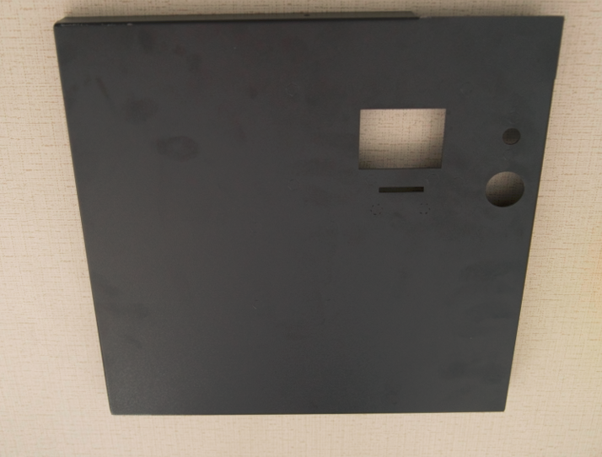
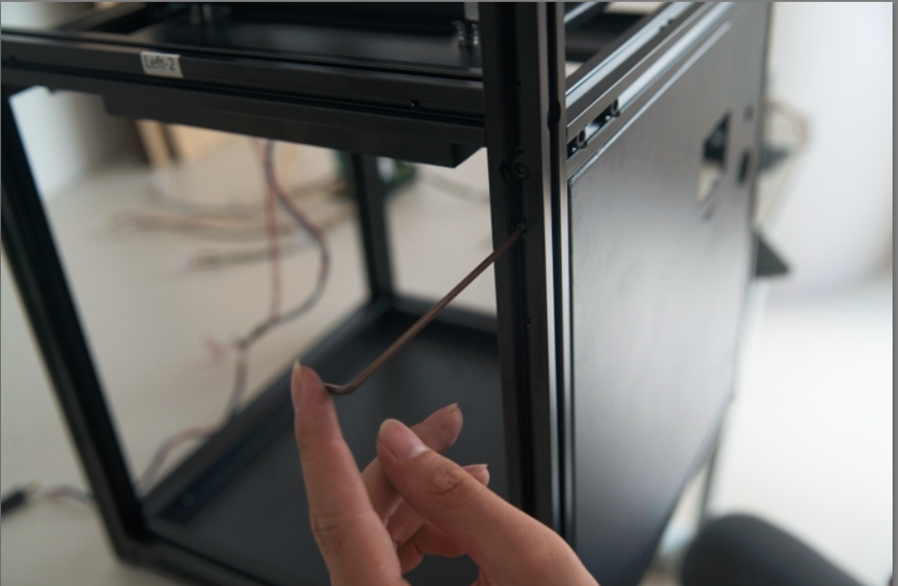
Find the Front Panel. Install it on the Front frame with 6 CH M3-20 screws. 2 each on Left/Right side. 1 each on Top/Bottom
if you insert the top (center) screw first it will hold the panel snugly against the top, and then the left and right screws will be easier to align.
Video Tutorial part 5

Slide 28
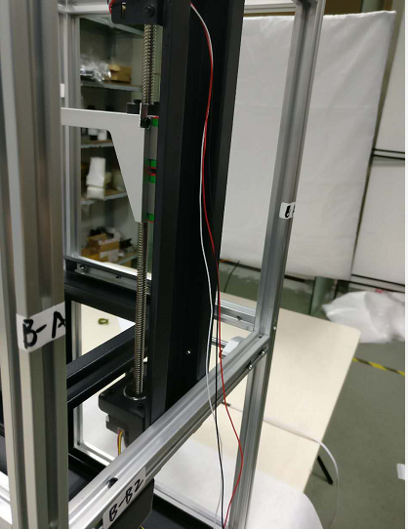
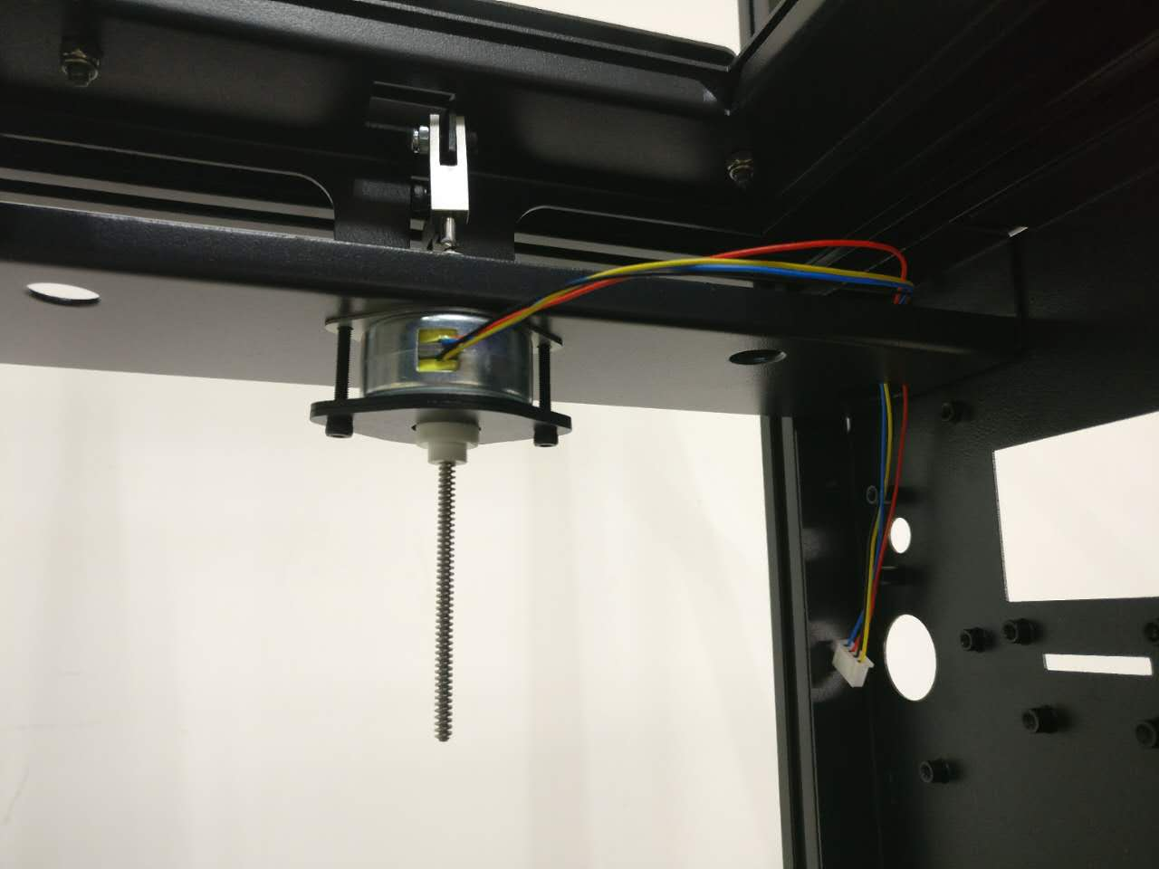
Now let’s organize the PM Motor cables and Endstop Sensor Cables as below (RS)
Video Tutorial part 5

Slide 29
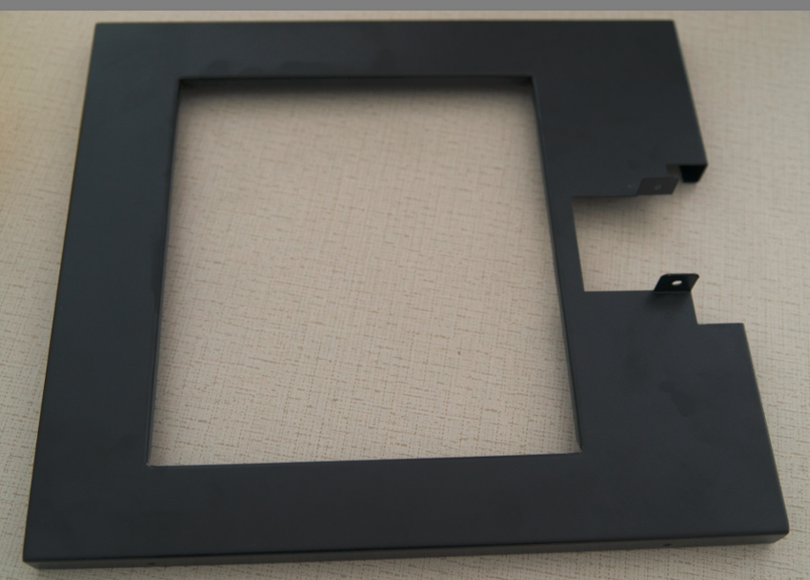
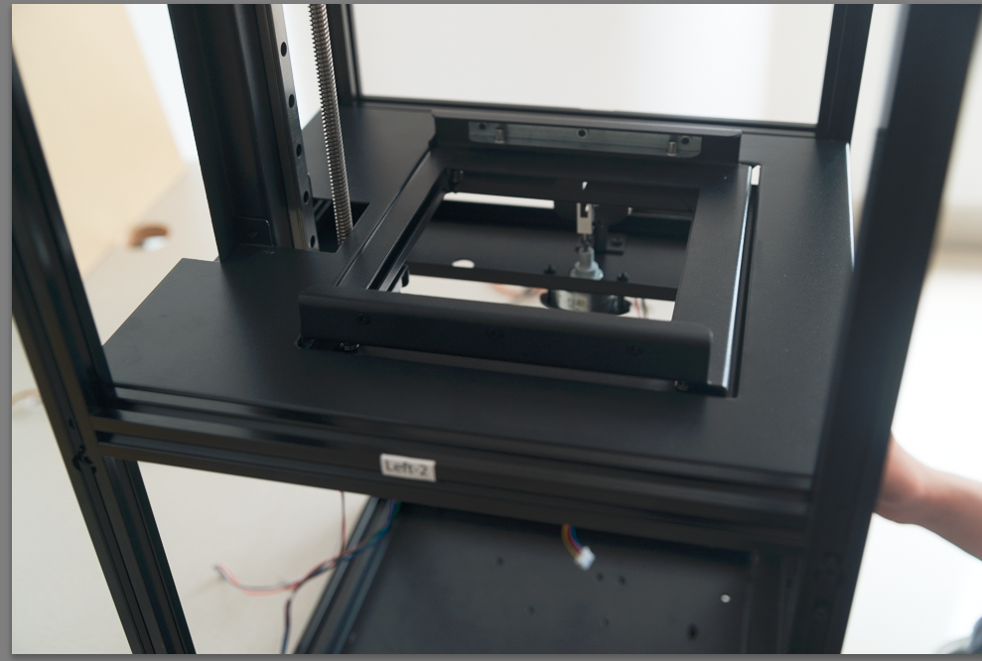
Find the Platform Cover, use 2 CH M3-6 to secure to Z-Axis Use 4 CH M3-20 to secure to Left and Right frame, 2 on each side. Video Tutorial part 5

Slide 30
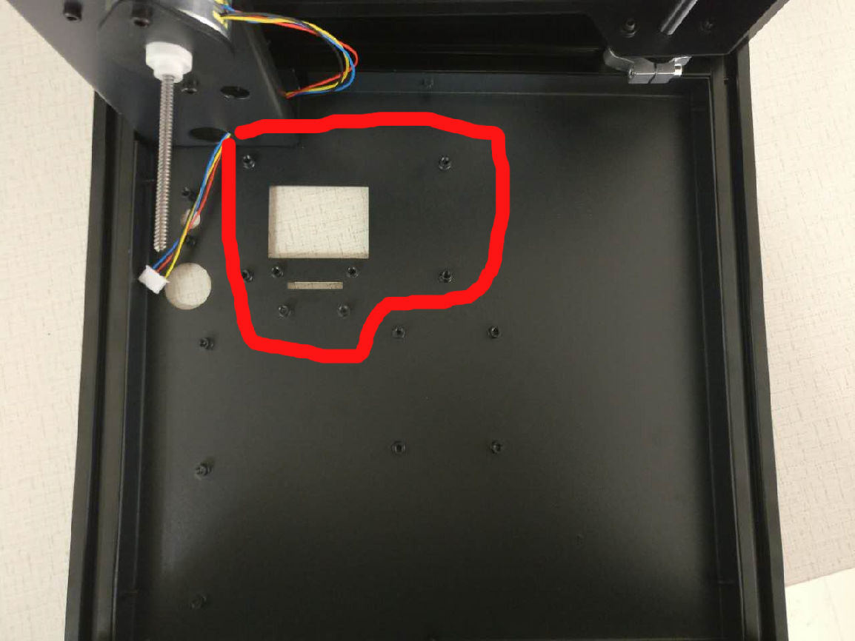
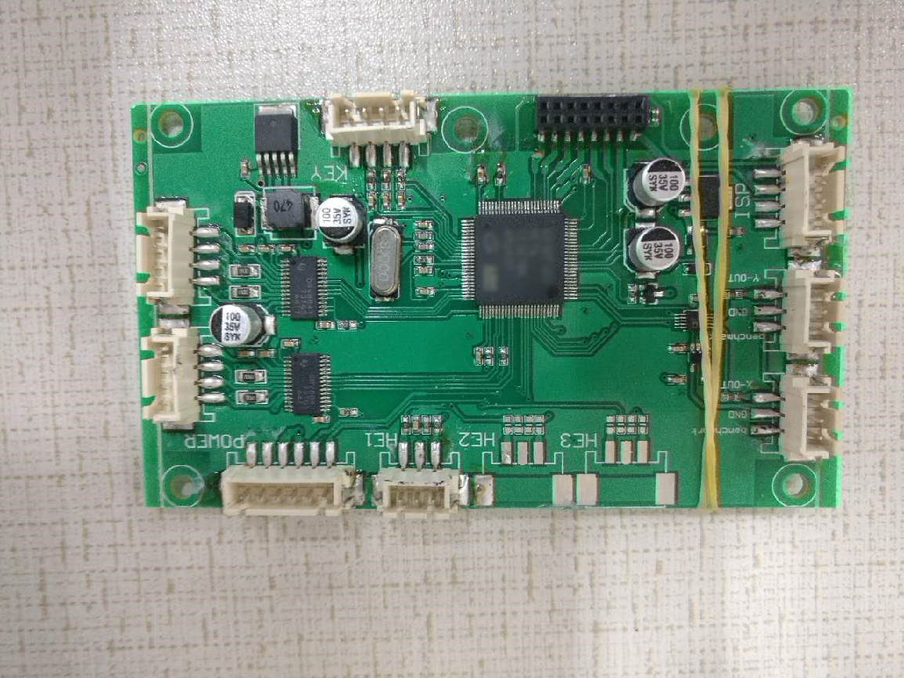
Lay the system down with Front Panel facing downward Install the processing board use CH M3-5 screws to tighten them. Make sure you remove the protective screen film before installing the board. here is a bigger picture of how all boards are next to each other. Top of picture is the riser and z-axis motor: https://drive.google.com/open?id=0Bzke6lBHG_z5dm5RdDdJTHRRMDQ

Slide 31
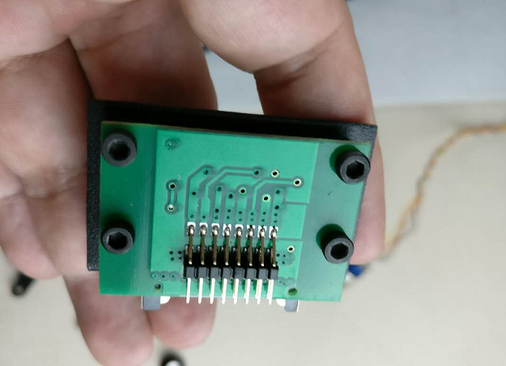
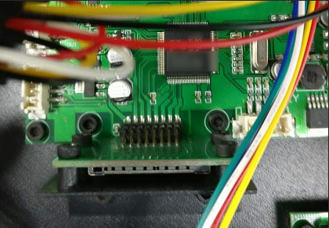
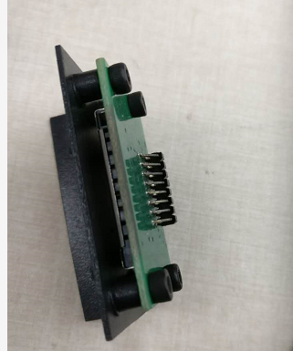
Install the SD card reader with an included metal plate. Secure with 4 CH M3-5 screws. The plug the SD reader with the plat on the main board and secure the plate with 2 CH M3-5 screws

Slide 32
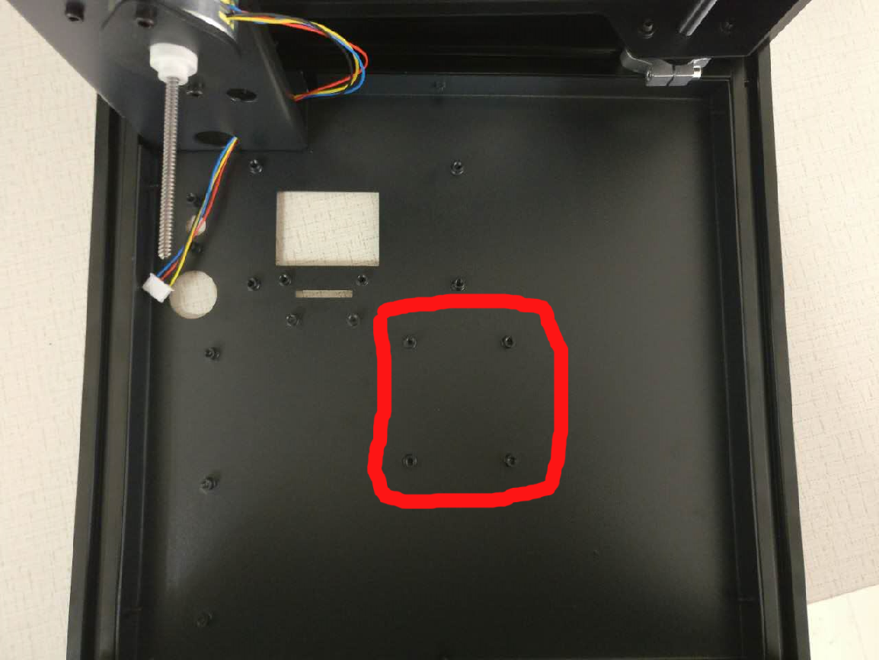

Secure the Power Board (lower right picture). Both using CH M3-5 screws here is a bigger picture of how all boards are next to each other. Top of picture is the Riser and Z-Axis motor: https://drive.google.com/open?id=0Bzke6lBHG_z5dm5RdDdJTHRRMDQ (Reshoot)

Slide 33


Secure the Power Board (lower left picture) and knob control (lower right). Both using CH M3-5 screws here is a bigger picture of how all boards are next to each other. Top of picture is the riser and z-axis motor: https://drive.google.com/open?id=0Bzke6lBHG_z5dm5RdDdJTHRRMDQ (Reshoot)

Slide 34
Cabling: All cables have labels on them The connection can be made by looking at below pics and match the port name to the cable label Diagram: needs update board picture reference: https://drive.google.com/open?id=0Bzke6lBHG_z5VWd2ZG1yQ182WE0 Driver picture reference: https://drive.google.com/open?id=0Bzke6lBHG_z5a1Ntek5tMUozNmM Laser/Galvo picture reference: https://drive.google.com/open?id=0Bzke6lBHG_z5V1RuM2dsNDFUYmM

Slide 35


Find and install Front Panel, Use 6 BH M3-16 screws to secure
it is probably easiest if you install the top screws first, then the cover will hang from them - and the rest of the holes will be aligned

Slide 36




Install Front Door to Front Panel, Find these pieces Use 4 FH M5x12 on the Door, Use 4 FH M5x25 to secure Door on the Panel

Slide 37



For Door Lock, find the Door Lock Set as seen on the left picture
push the Lock through the hole on the Door Panel from outside in, screw the Ring in from the inside of the panel, put the Lock Arm as seen in the right picture. Then use the Screw to secure the Lock Arm

Slide 38


Find Knob Cover Install Knob Cover to Front Panel, there should be a metal beam sticking out from the Control Unit We include both Black and Silver knob for your preference

Slide 39


Find Knob Cover Install Knob Cover to Front Panel, there should be a metal beam sticking out from the Control Unit We include both Black and Silver knob for your preference

Slide 40


Find Power Switch (See left picture) There is rubber ring and a metal ring. Remove both before installing

Slide 41


Make sure insert Power Switch with cable through the Front panel holes Put on rubber ring and then a metal ring. Secure the Power Switch from the back buy put rubber ring all the way in first and tighen the metal ring. Contact the Power Switch Cable to the highlighted port

Slide 42



Install Back panel for Back frame, you can Identify it by the hole Install Power Cable by pull a part of cable thru Back Panel’s hole. Use 6 BH M3-16 screws to secure**
it is probably easiest if you install the top screws first, then the cover will hang from them - and the rest of the holes will be aligned.

Slide 43


Before you close it up, please check out how to manage all the cables so it doesn’t block off laser or caught by motor: here is the document: https://drive.google.com/open?id=10Hs4L5ChrQcMRv-hTj1OjxoXU1Nje65PGSYR9zzE0nU

Slide 44



We recommend you do this last step ONLY AFTER YOU PRINTER PASS ALL the CALIBRATION and TEST PRINT because panels may hinder leveling. USE Protection Glass when running test with panels off! Install Left, Right and the Top. Use 6 BH M3-16 screws to secure each panel on the Right and Left. 4 for the Top Panel. Make sure the slant on the panel is facing outward.

